Slide 1
Overview Venture Creation And Team Setup
Dr. Glory Aguzman, S.Sos, M.M., CDMS, CCP

Slide 2
Subtopics
Binus Entrepreneurship journey
Schedule
Assignment
Final Project
BEC Apps
Exhibition Offline & Online
10 Questions to Develop Your Entrepreneur Mindset
The Myth Of Entrepreneurship
Supporting – Team Set Up
Student Activities
Next Session Preparation

Slide 3
Acknowledgements
Course Description: Venture Creation
This course provides students with practical experience in transforming prototypes into viable business ventures. Students will refine their ideas, validate them through exhibitions, and explore key aspects of entrepreneurship such as customer validation, business models, and pitching.
By the end of the course, students will be able to assess the feasibility of their business ideas, compile a business report, and prepare an investor-ready pitch deck as a step toward building sustainable ventures.
Learning Outcomes – Venture Creation
LO1: Create a prototype relevant to market needs.
LO2: Test the prototype to assess business potential.
LO3: Create a business report and pitch deck for sustainable business development.

Slide 4

Binus Entrepreneurship Journey
Creativity and Innovation Course
Venture Creation Course
Enrichment 1st Semester
Enrichment 2nd Semester
BINUS INCUBATOR
BINUS Entrepreneurship Center
(BEC)

Slide 5
Schedule
Week | TOPIC | TYPE | DURATION | TOOLS
1 | Venture Creation Overview & Team Setup | F2F | 100’
2 | Opportunity Recognition & Problem Framing | F2F | 100’
3 | Prototype Development (Low Fidelity) | F2F | 100’
4 | Prototype Testing (Customer Discovery) | GSLC
5 | Prototype Iteration & Feedback | F2F | 100’
6 | Business Model Canvas | F2F | 100’
7 | Business Model Canvas Redevelopment | F2F | 100’ | Domain Expert/ Assignment I
8 | Digital Marketing & Traction Tools | F2F | 100’
9 | Business Festival Showcase | GSLC |  | Assignment II
10 | Business Ethics & Legal Foundations | F2F | 100’
11 | Entrepreneurial Finance & Valuation | F2F | 100’
12 | Pitch Deck & Market Reflection | F2F | 100’
13 | Business Report | F2F | 100’

Slide 6
Assignment
ASSIGNMENT II (30%)
Present the prototype validation process in your video, covering the following key aspects:
Problem–Solution Validation
Demonstration & Improvement
Business Potential Evaluation
Presentation & Communication Quality
Teamwork & Professionalism
Assignment Instructions
Title: Business Showcase Video Report
Duration: 3–5 minutes
Format: A video presentation that demonstrates the prototype validation process and highlights the results of market reflection.
Style: Present in an engaging, creative, and innovative manner that effectively captures and maintains audience attention.
Submission Type: Individual
Submission Period: Week 10
ASSIGNMENT I (30%)
BMC Redevelopment Report:
Foto prototype
Business Model Canvas
Assignment Instructions:
Submission Type: Individual
Submission Period: Week 7

Slide 7
Rubric Assignment I
BMC Redevelopment Report
No | LO | Assessment Aspect | Excellent (90–100) | Good (75–89) | Fair (60–74) | Poor (<60) | Weight (%)
1 | LO 2 | Prototype Representation | Prototype image is clear, detailed, and effectively communicates the core concept of the product. | Prototype is clear but lacks supporting detail or explanation. | Prototype displayed but visually incomplete or lacks clarity. | Prototype unclear or missing. | 25
2 |  | Alignment Between Prototype & BMC | Strong, logical connection between prototype features and key BMC elements (value proposition, customer segments, channels, etc.). | Clear linkage between prototype and some BMC elements, but not fully integrated. | Partial connection; unclear how prototype supports BMC structure. | No visible relation between prototype and BMC. | 25
3 |  | BMC Redevelopment (9 Building Blocks) | All 9 blocks are completed comprehensively and revised based on prototype validation results. | Most blocks completed with partial updates and moderate reasoning. | Several blocks incomplete or lack clear rationale for changes. | BMC incomplete or copied without meaningful revision. | 30
4 |  | Market Feedback Reflection | Includes concise and relevant reflection or data showing how user feedback informed the BMC changes. | Mentions feedback but limited explanation of how it influenced revision. | Feedback mentioned briefly with no clear connection to BMC. | No feedback or reflection included. | 20

Slide 8
Rubric Assignment II
Business Showcase Video Report
No | LO | Assessment Aspect | Excellent (90–100) | Good (75–89) | Fair (60–74) | Poor (<60) | Weight (%)
1 | LO2. | Problem–Solution Validation | Clearly demonstrates user testing or customer discovery with real evidence (interviews, observation, or survey results). Shows strong relevance between user problem and prototype solution. | Presents limited user testing or feedback with partial evidence of relevance to problem. | Validation shown is mostly assumption-based with minimal data. | No real validation shown; problem-solution connection unclear. | 20
2 |  | Prototype Demonstration & Improvement | Prototype is clearly demonstrated; improvement and iteration from prior feedback are visible and well explained. | Prototype demonstrated with minor refinement based on feedback. | Prototype shown but lacks explanation of iteration or improvement. | Prototype unclear, not functional, or unrelated to validation. | 20
3 |  | Customer Feedback & Market Reflection | Shows comprehensive feedback from users and provides a clear reflection of market response (charts, testimonials, or qualitative insights). | Shows some feedback data with basic interpretation. | Mentions user feedback but lacks meaningful analysis or visualization. | No evidence of market feedback or reflection. | 20
4 |  | Business Potential Evaluation | Logically evaluates business potential using evidence from validation (market size, traction, customer interest, or competitive advantage). | Provides general discussion of potential with limited supporting data. | Mentions potential superficially without supporting analysis. | No evaluation of business potential provided. | 20
5 |  | Presentation & Communication Quality | Video is engaging, logically structured, clear in narration, visually appealing, and within time limit (3–5 mins). | Video is clear but lacks strong flow or professional editing. | Video understandable but disorganized or poor in sound/visual quality. | Video unclear, incoherent, or incomplete. | 10
5 |  | Teamwork & Professionalism | All members actively contribute; roles are clear; delivery is professional and collaborative. | Most members contribute; some imbalance in participation. | Limited collaboration; unclear roles. | No visible teamwork or professional conduct. | 10

Slide 9
FINAL PROJECT
Business Report (40%)
Cover : Team Name, Student Number, Binus Logo, Class Code, Lecturer Name; Lecturer Code
PitchDeck Structure
Title & Problem Statement – What problem are you solving?
Solution / Product Idea – What’s your innovative offer? – Feedback Grid
Market Size– TAM, SAM, SOM.
Business Model – BMC
Marketing Strategy – How will you reach customers?
Financials – COGS - Include revenue, cost, and BEP analysis.
Team & Roles – Who is behind this project?
Closing / Call to Action – Why should we invest in you?
Binus Festival Documentation (Foto & Video link)
Intellectual Property Plan
Market Validation Reflection
Prepare a Business Report, summarizing your startup development journey:
Market validation & traction evidence
Submission format :Individual
File format: PDF (Business Report)
Business Report Design: Creative and DIY

Slide 10
Rubric Final Project
Business Report
NO | LO | Assessment Criteria | Excellent (85–100) | Good (70–84) | Fair (55–69) | Poor (<55) | Weight
1 | LO1 | Introduction & Team Setup | Clear, engaging introduction with strong motivation and clearly defined team roles; demonstrates collaboration and sustainability mindset. | Clear introduction with some motivation and defined roles. | Adequate introduction, but motivation or roles lack detail. | Weak or missing introduction; unclear team structure. | 15
2 | LO1 | Opportunity Recognition | Clearly identifies a significant sustainability problem/trend; value proposition is innovative and impactful. | Identifies a relevant problem/trend; value proposition is logical | Problem/trend identified but lacks depth or sustainability focus. | Problem/trend vague; little or no value proposition. | 15
3 | LO2 | Business Model Canvas (BMC) Redevelopment | Creates a comprehensive, coherent, and professional report integrating sustainability and innovation seamlessly. | Creates a clear and complete report with some integration of sustainability and innovative ideas.. | Creates a basic report with partial structure or limited sustainability focus. | Creates an incomplete or poorly organized report lacking sustainability focus. | 15
4 | LO3 | Digital Marketing | Creates content professionally on Newbisanara and one social media platform that reflects sustainability values, branding, and engagement results. | Creates content effectively with moderate engagement and clear branding.. | Creates content with basic visuals or limited sustainability focus. | Creates content that lacks clarity, consistency, or engagement. | 15
5 | LO3 | Validation (BINUS Festival + Complete Documentation) | Presents validation confidently at BINUS Festival with complete documentation (photos, videos, feedback, reports). | Presents validation with partial documentation and moderate clarity.. | Presents limited validation with weak supporting evidence | Fails to present or document validation | 15
6
7 | LO3 | Ethics & Legal | Applies ethical and legal frameworks effectively in planning sustainable and compliant business operations. | Applies most ethical and legal principles appropriately. | Applies basic or limited ethical awareness. | Fails to apply ethical or legal considerations. | 5
8 | LO3 | Finance & Valuation | Performs accurate financial calculations (TAM–SAM–SOM, BEP) using realistic data and tools | Performs calculations correctly with minor errors. | Performs basic or incomplete calculations | Fails to perform financial analysis. | 5
9 | LO3 | Pitch Deck | Creates and delivers a professional, coherent, and persuasive pitch deck demonstrating critical analysis of market data, evaluation of business feasibility, and creativity in value proposition; effectively integrates sustainability impact and confidently articulates next steps. | Develops and presents a clear and engaging pitch deck with relevant content and logical flow; shows sound understanding of business and sustainability aspects but lacks depth in some areas.. | Demonstrates a basic understanding of the pitch structure; content is partially organized with limited analysis, creativity, or confidence in delivery. | Shows minimal understanding or preparation; the pitch lacks clarity, coherence, and evidence of analysis or creativity. | 5
10 | LO3 | Market Validation Reflection | Adapts future action through critical reflection on outcomes and team performance (pivot/continue/stop). | Reflects adequately with some insight for improvement. | Reflects descriptively without adaptation. | Shows no reflection or awareness. | 5
11 | LO3 | Presentation & Report Quality | Creates an original, professional, and persuasive business report and pitch deck integrating sustainability values. | Creates a clear and engaging report and presentation. | Creates a basic report with limited organization or visuals. | Fails to create a coherent or complete report. | 5

Slide 11
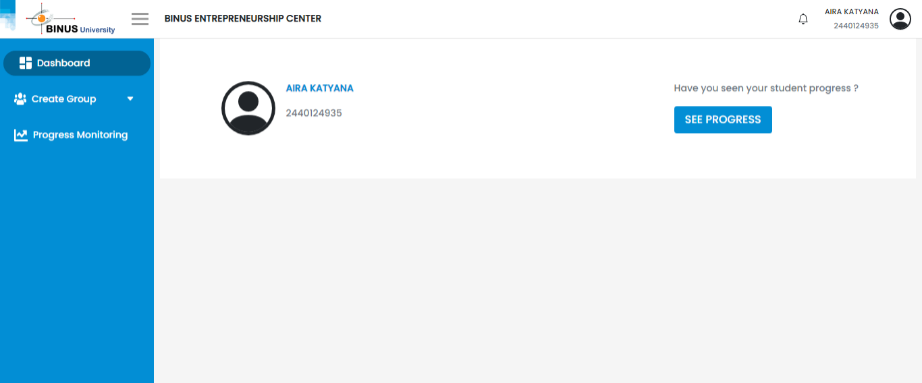

BEC APPS
BEC Apps empowers students, lecturers, and collaborators to actively engage in entrepreneurship learning—making it more dynamic and impactful.
Through BEC Apps, users can easily form groups, register for seminars or workshops, and join activities that enhance their entrepreneurial journey.
Guides are available on Binus Maya to help you make the most of it.
Group registration is open from Week 1 to Week 4
Let’s create, collaborate, and innovate together!

Slide 12
EXHIBITION OFFLINE & ONLINE

Slide 13
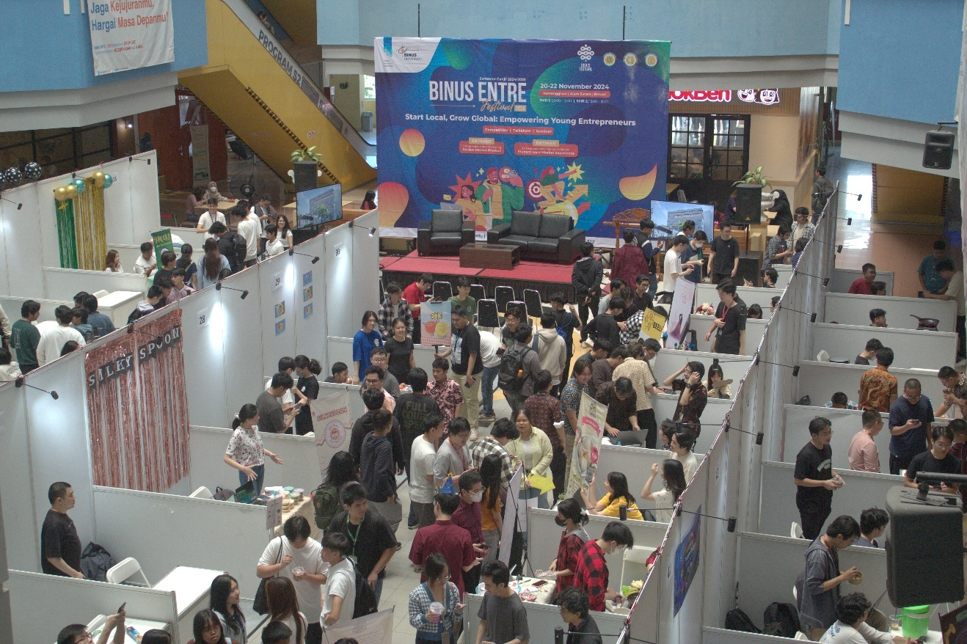
Binus Festival (BiFest)
Binus Festival is Event in GSLC Week Serves as a platform for offline market validation, which is mandatory for the assignment and Final Project of the Venture Creation course provided by the Binus Entrepreneurship Center.
Enroll using BEC Apps

Slide 14
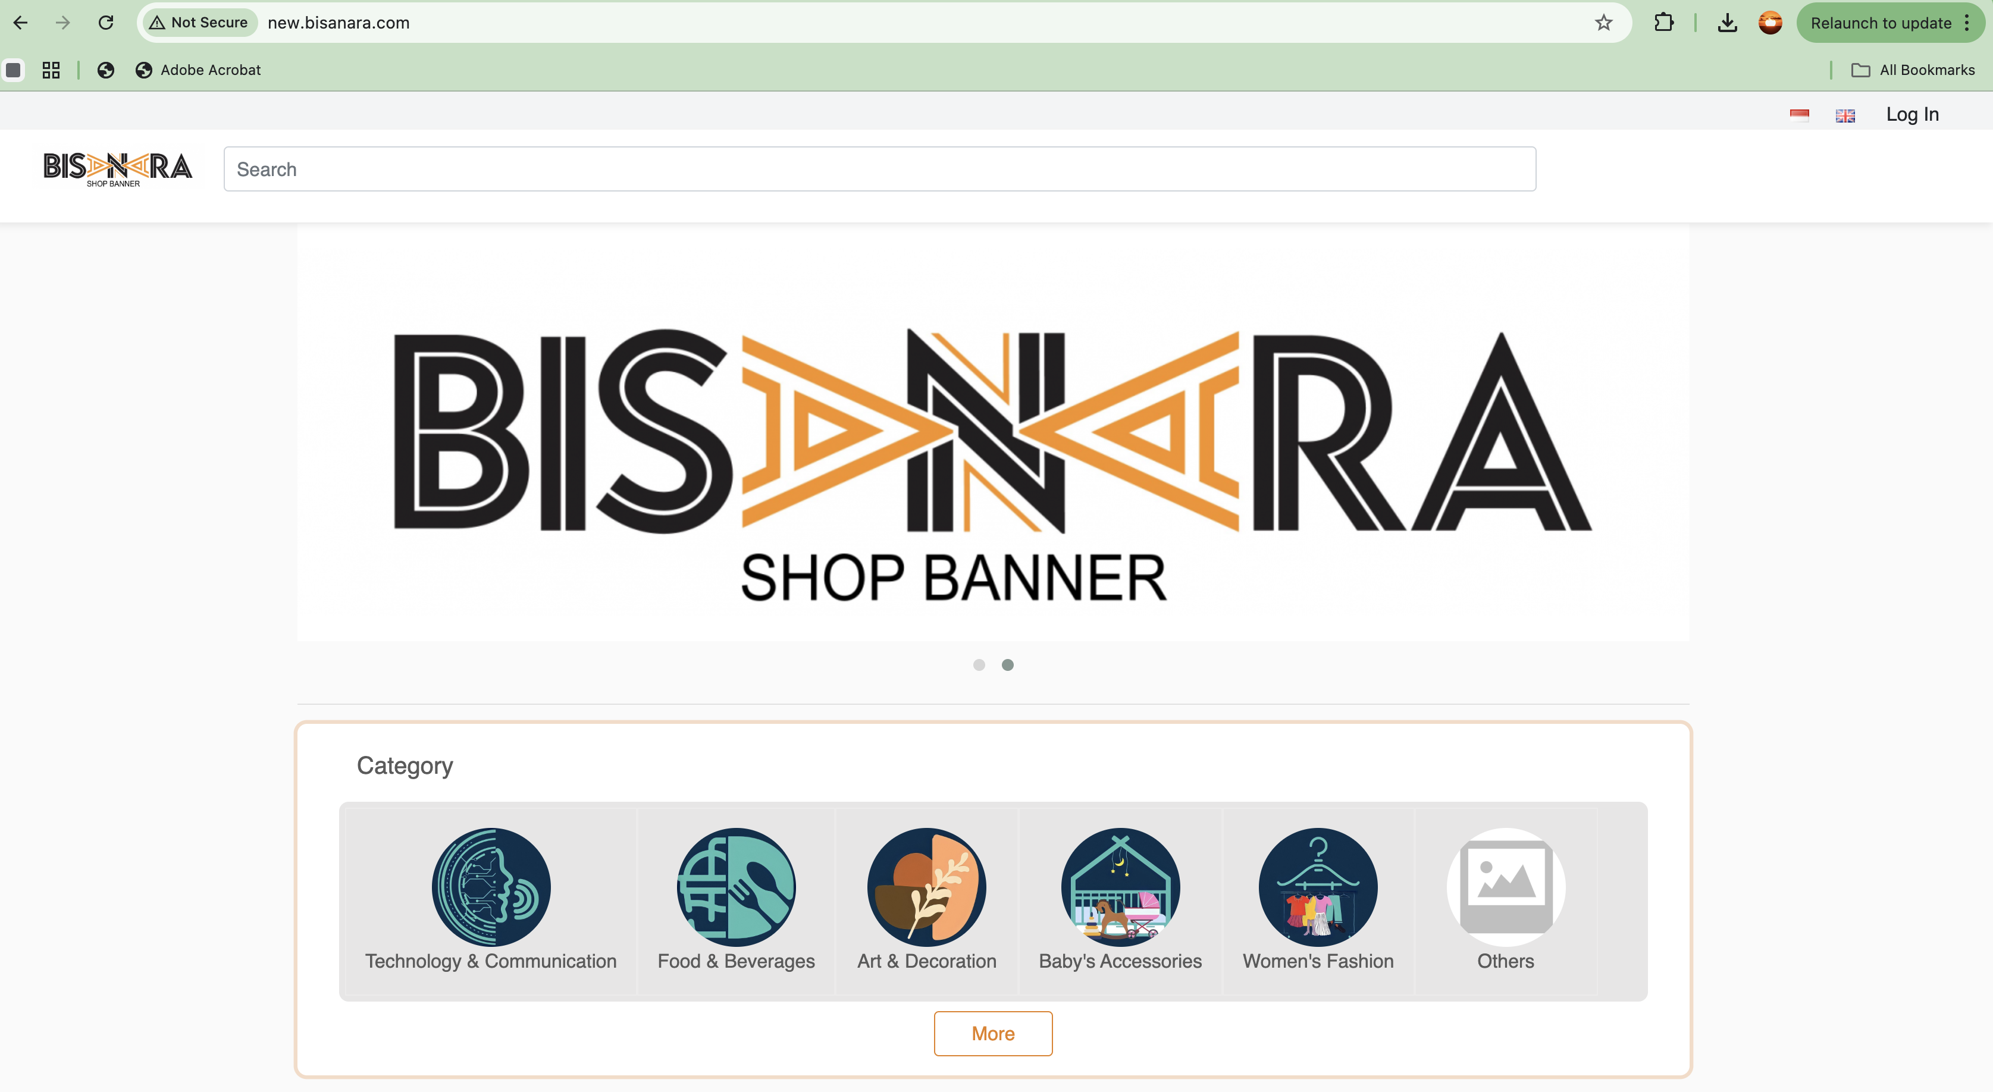
NewBisanara
Welcome to NewBisanara.com — your go-to platform to discover, share, and showcase a wide range of goods and services anytime, anywhere.
More than just an online marketplace, Bisanara is a space where possibilities come alive. True to its name Bisa Naruh Apa Aja, you can sell, share, and explore virtually anything!
🚀 Start your journey today at NewBisanara.com
🎥 Watch the guide here: https://youtu.be/1leygeakD6c

Slide 15
10 Questions to Develop Your Entrepreneur Mindset
By reflecting on these questions and considering how you approach the entrepreneurial mindset, you can gain a deeper understanding of your strengths, weaknesses, and areas for growth.
This can help you develop and cultivate the skills and characteristics necessary for success in the entrepreneurial world.
Here are ten questions to reflect on an entrepreneurial mindset:
Opportunity Hunter: : What untapped opportunities can you discover in your field or industry?
Innovation Driver : How can you creatively solve complex problems and make decisions that challenge the status quo?
Risk Taker : Are you prepared to take well-calculated risks to propel your goals forward?
Resilience Builder : When faced with setbacks and failures, how do you bounce back and use these experiences to your
advantage?
Ambiguity Navigator : How do you embrace and thrive in situations filled with uncertainty and ambiguity?
Adaptability Champion : In a rapidly changing world, what strategies do you employ to stay adaptable and flexible?
Visionary Leader : Can you articulate a compelling vision that inspires and guides your business or venture?
Time Master : How do you effectively manage your time, ensuring it’s focused on high-impact activities?
Innovative Thinker : Are you open to adopting new ideas and perspectives to foster innovation?
Collaboration Maestro : What steps do you take to cultivate productive collaborations and build strong relationships for
shared success?

Slide 16
The Myth Of Entrepreneurship
Myth | Reality
Entrepreneurs are born, not made | Entrepreneurship is a learned skill — mindset and method can be developed
Entrepreneurs take big risks | Successful entrepreneurs minimize risks through testing and validation
A great idea guarantees success | Execution and market fit matter more than the idea itself
Entrepreneurs work alone | Building a strong, complementary team is key
Entrepreneurship is about money | It’s primarily about creating value and solving problems

Slide 17
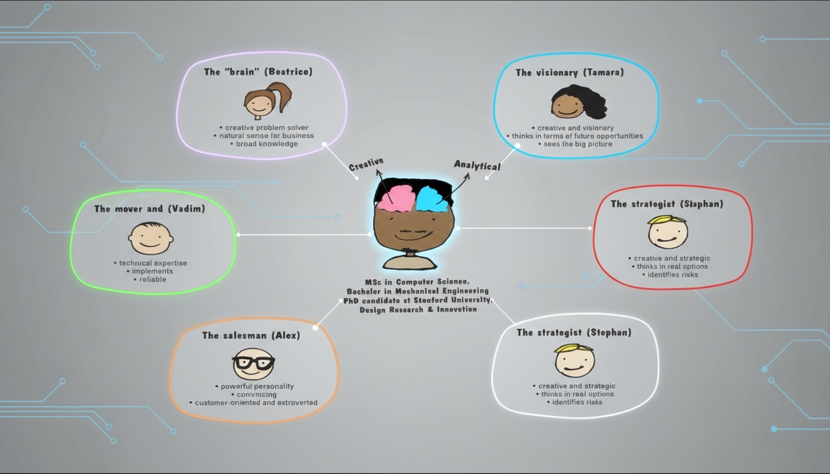
Supporting Roles – Team Set Up
Beatrice – The Brain
Traits: Creative, strategic thinker with strong business sense.
Focus: Provides intellectual and problem-solving support.
2. Tamara – The Visionary
Traits: Big-picture thinker, imaginative, future-oriented.
Focus: Guides long-term goals and opportunities.
3. Stephan – The Strategist
Traits: Analytical, practical, risk-aware.
Focus: Balances creativity with realism and smart decision-making.
4. Vadim – The Mover and Shaker
Traits: Technically skilled, reliable, action-driven.
Focus: Turns ideas into working solutions.
5. Alex – The Salesman
Traits: Charismatic, persuasive, customer-focused.
Focus: Builds relationships and drives buy-in for projects.

Slide 18
Student Activities
Head prefect Election (Komti)
Create Groups (each group consist of 3 until 5 people)
Send Your Group Name with Name, NIM and Your Position to Komti
Note: If you have already registered, please use that group.

Slide 19
Next Session Preparation
Opportunity Recognition
Answer 10 Explaining Key Product & Market - Video : https://youtu.be/QMsGrDxWR3o
Present Opportunity Recognition & 10 Key Product & Market:
Cover
Opportunity recognition
10 Explaining Key Product & Market
Get Feedback from Lecturer

Slide 20
References
Entrepreneurship successfully Launching New Ventures, 7th Edition, Bruce R. Barringer, R. Duane Ireland, 2025
The Entrepreneur Mindset JD Meier.pdf

